Slide 4
HttpClient handlers pipeline

Slide 5
Using HttpClient handlers to mock HTTP calls

Slide 6
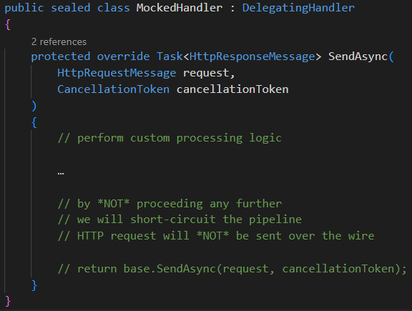
Using HttpClient handlers to mock HTTP calls

